Slide 1
Nervous System Neoplasm
BIO392 Project Presentation
Luca Tobler
Solange Jost
Roman Stadler

Slide 2
Introduction
Nervous System Neoplasm = Brain tumors + Spinal tumors
Among the most fatal cancers in adults as well as children and adolescents
Symptoms: Headache, nausea, partial loss of sensory and motor function
Classification:
Spinal cord tumors
Peripheral Nerve tumors
Meningiomas
Brain tumors
Gliomas and Ependymomas
Astrocytomas
Oligodendrogliomas
Glioblastomas
Medulloblastomas
Notes:
wide collective term for all types of brain and spinal cord tumors
symptoms: problems with vision, speech, hearing, coordination of movements
Classification
→ primary vs. secondary tumors! (tumor metastasize to another region)
→ differentiation between malignant and benign
in our data, the classification is based mainly on histology
ependyma = tissue of the CNS
Glioblastoma: very fast-growing, most aggressive
Medulloblastomas start in cerebellum, most often found in children
Meninges = membranes that surround brain and spinal cord
Meningiomas: usually not malignant

Slide 3
Aim
Does survival differ among different subtypes of Nervous System Neoplasms?
How do copy number variations in four genes of interest affect survival?
Are there differences in survival between male and female patients?

Slide 4
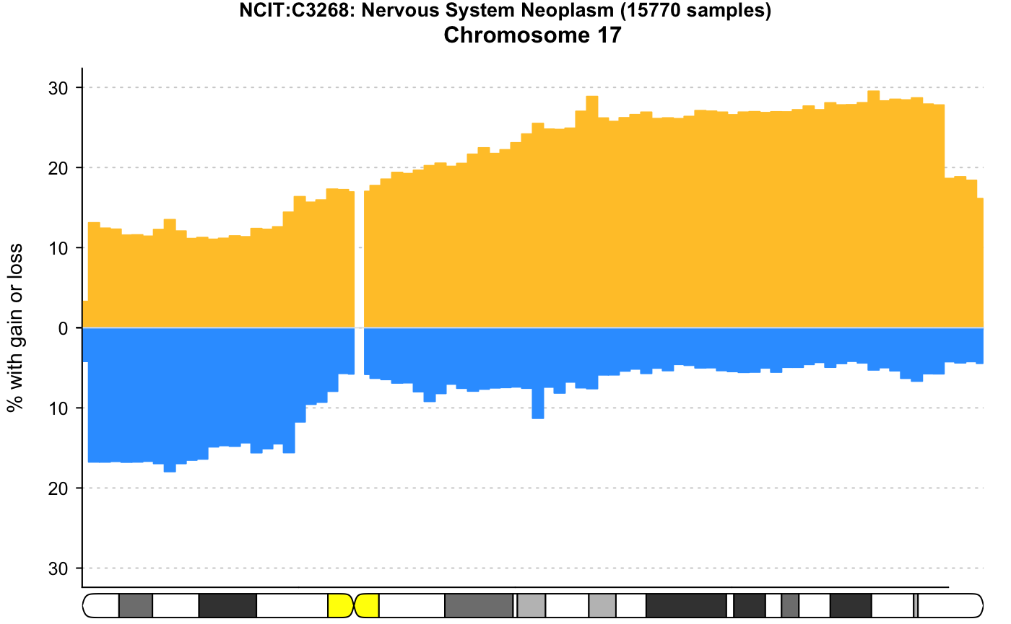
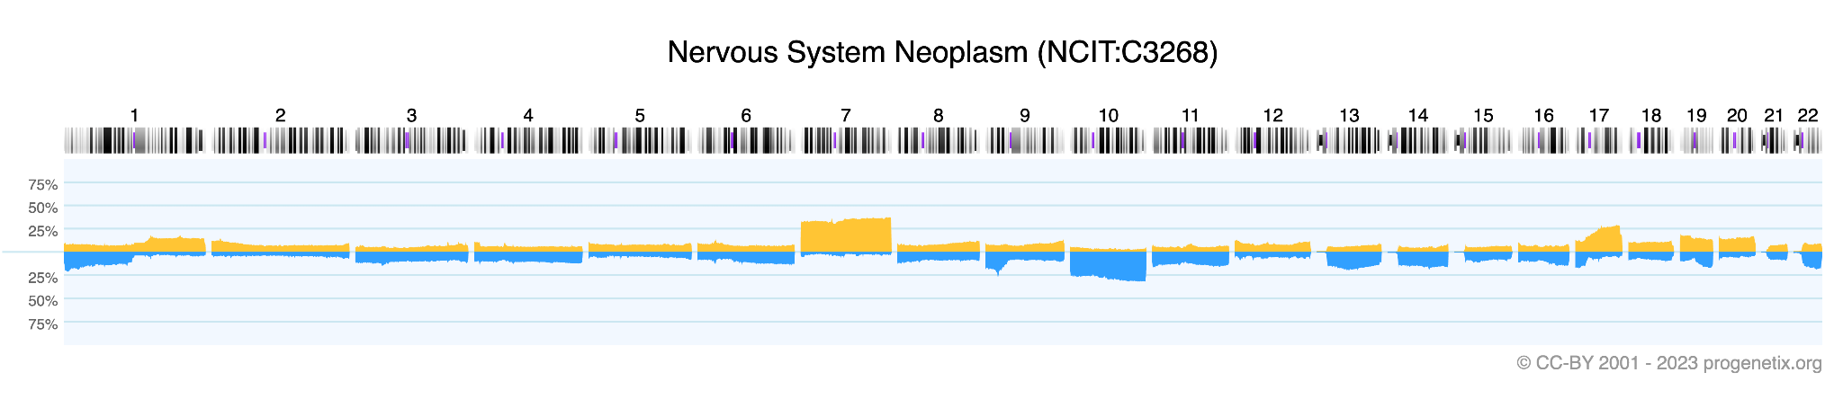
Genome wide look
Locations
MYC: 8q24.21
CDKN2A: 9p21.3
ERBB2: 17q12
TP53: 17p13.1
TP53
ERBB2

Slide 5
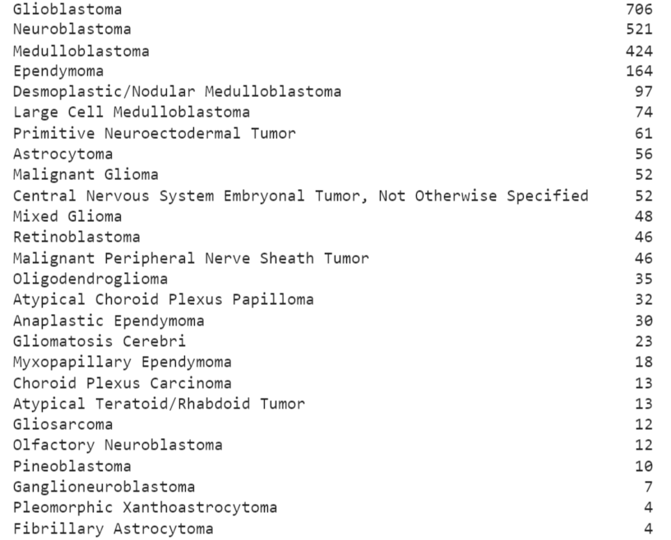
Data
2560 biosamples
26 cancer types, histologically classified
CN variation data from progenetix.org
Focus:
Duplications in oncogenes (MYC, ERBB2)
Deletions in tumor suppressor genes (TP53, CDKN2A)
1325 samples after merging

Slide 6
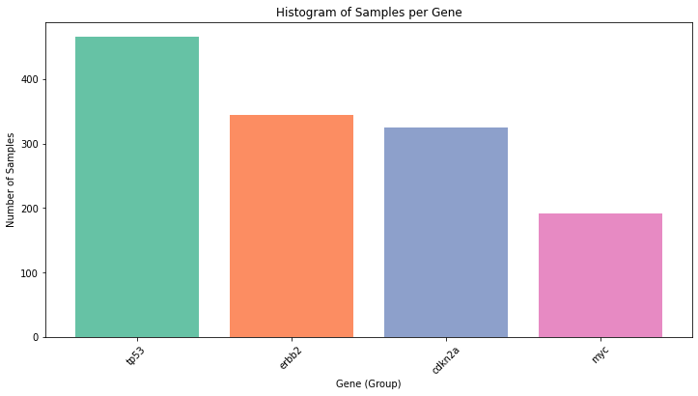
Data

Slide 7
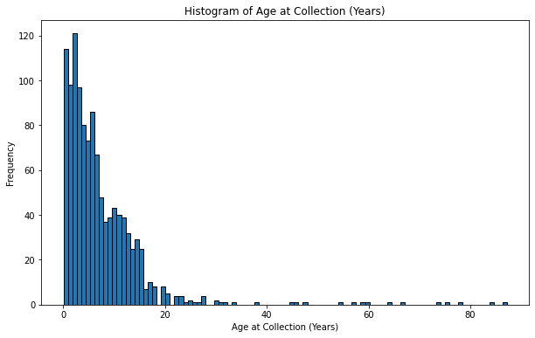
Data

Slide 8
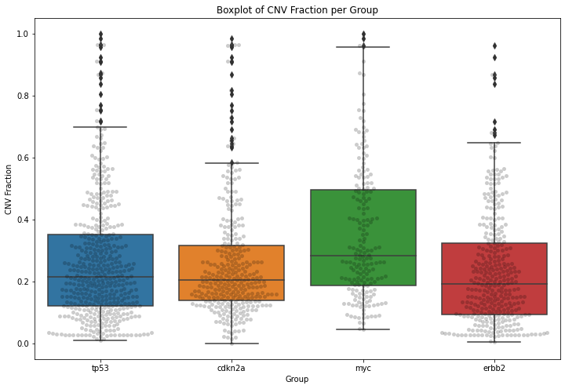
Data

Slide 9
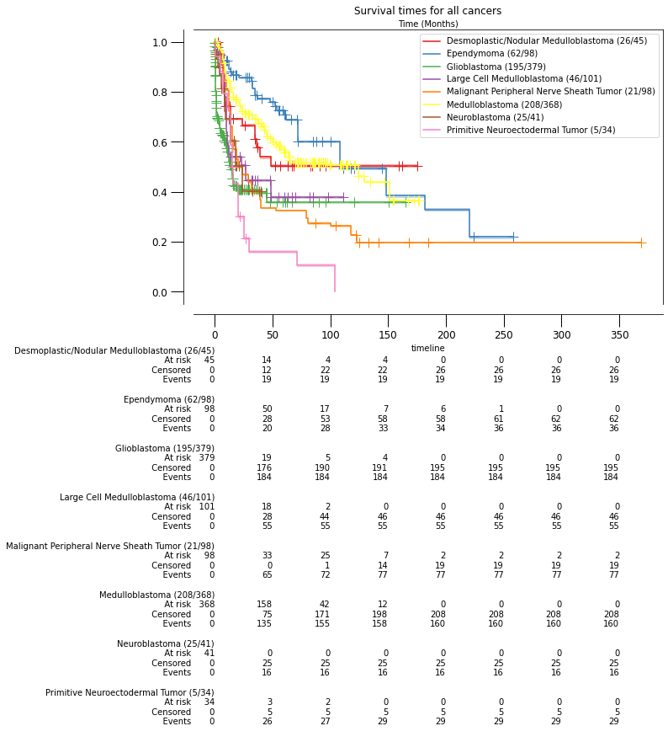
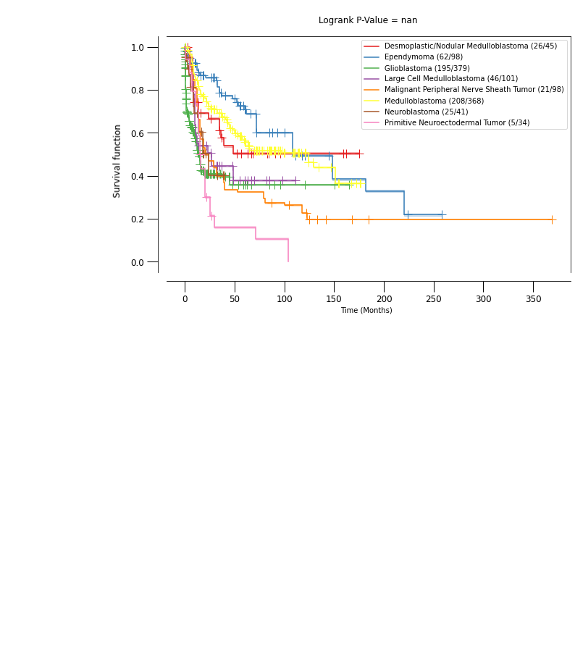
Results

Slide 10
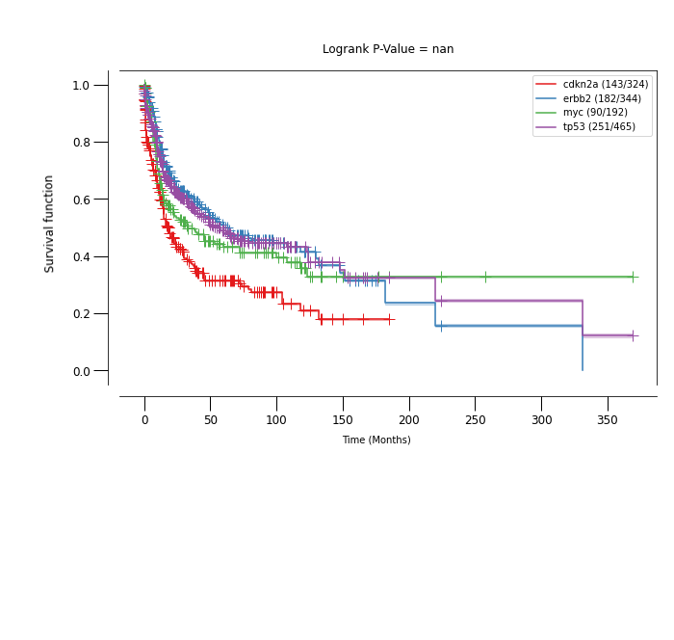
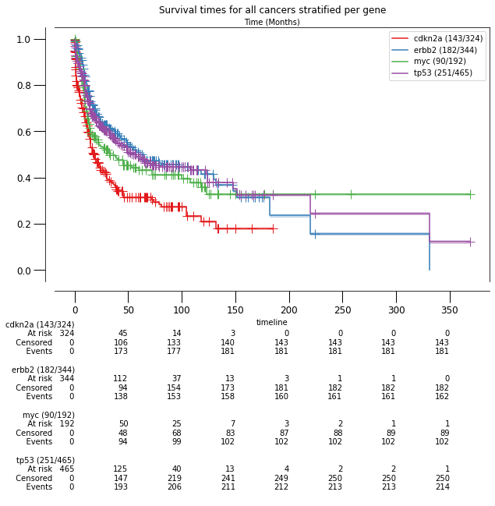
Results

Slide 11
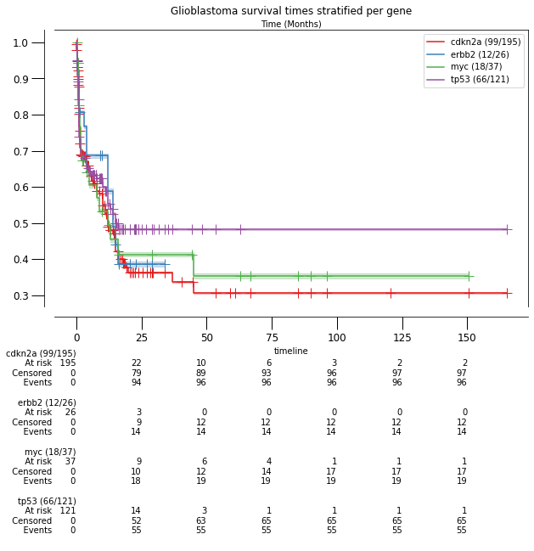
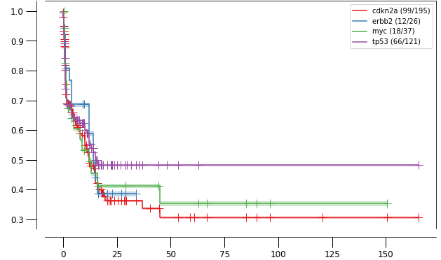
Results

Slide 12
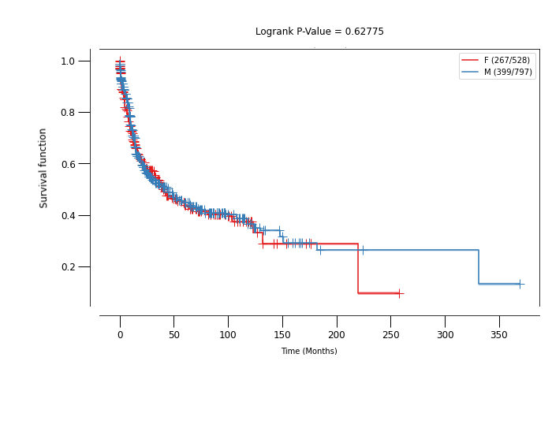
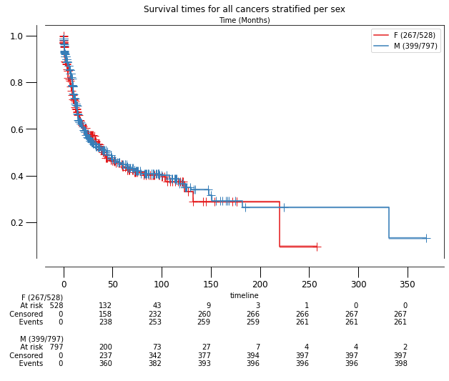
Results

Slide 13
Conclusions
Kaplan Meier Estimates:
p-value not calculated for the gene groups
Not significant for the sex:
No evidence against the null hypothesis that their hazard functions are identical
Differences in survival time, visible in aggressive tumor types
Survival time shortest with variations on cdkn2a
No difference between male and female observations

Slide 14
Conclusions
Limitations:
Age distribution very skewed
Kaplan Meier measures survival time after sample collection
might be different per age group
No reference group for the survival times
Extensions:
Cox Regression for the survival times
add the covariates age and gene groups (factor variable)
gives either Hazard Ratios or Accelerated Failure Time

Slide 15
Sources
https://en.wikipedia.org/wiki/Logrank_test (logrank test)
https://www.msdmanuals.com/home/brain,-spinal-cord,-and-nerve-disorders/tumors-of-the-nervous-system/overview-of-brain-tumors (classification of tumors)
https://www.cancer.gov/types/brain/patient/adult-brain-treatment-pdq (symptoms)
https://progenetix.org/ (data)

